Slide 1


Jay Huang
08/10/2022

Slide 2

Outline
Executive Summary
Introduction
Methodology
Results
Conclusion
Appendix

Slide 3
Executive Summary
Summary of methodologies
Summary of all results:
By using different classification models such as Logsitic Regression, Support Vector Machine, Decision Tree, and K nearest neighbor.
Gainning accuracy of 83.33%, 83.33%, 77.8%, 83.33% respectively.

Slide 4
Introduction
Project background and context
Problems you want to find answers

Slide 5

Section 1

Slide 6
Methodology
Executive Summary
Data collection methodology:
Data were collected by using wget with URL
Perform data wrangling
Data were processed by removing null value, using standard scaler to normalize them, as well as encode categorical data
Perform exploratory data analysis (EDA) using visualization and SQL
Perform interactive visual analytics using Folium and Plotly Dash
Perform predictive analysis using classification models
Built classification models by applying packages from Sklearn and tune model using GridSearchCV. Using AUC-ROC curve, confusion matrix, and F1 score to evaluats

Slide 7
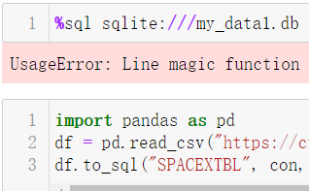
Data Collection
Describe how data sets were collected.
You need to present your data collection process use key phrases and flowcharts

Slide 8
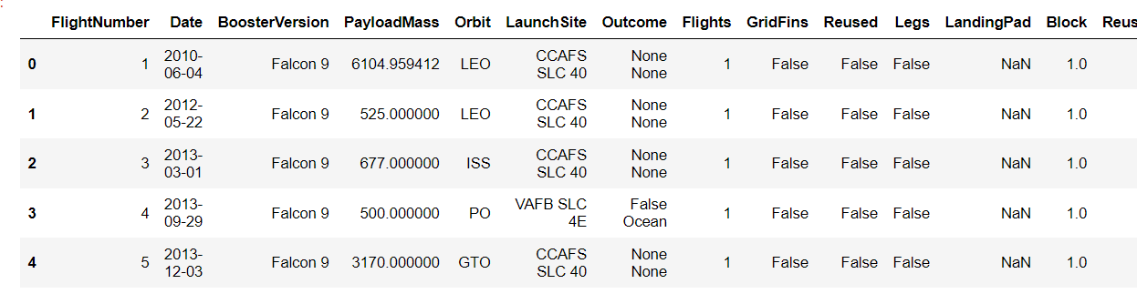
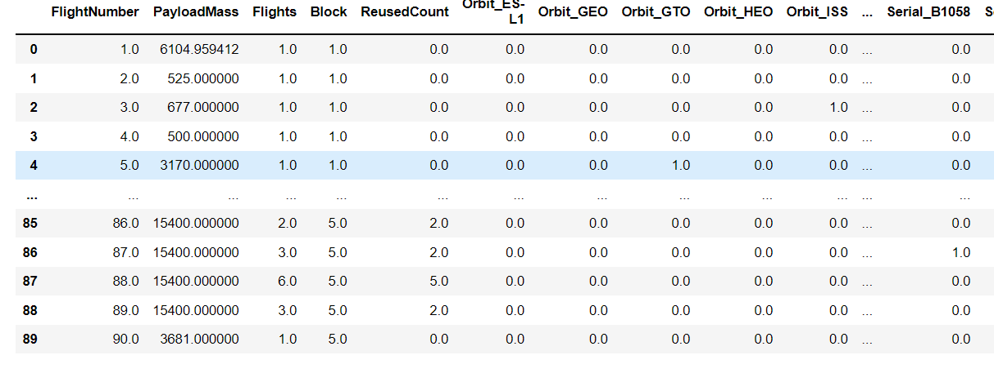
Data Collection – SpaceX API
Present your data collection with SpaceX REST calls using key phrases and flowcharts
Add the GitHub URL of the completed SpaceX API calls notebook (must include completed code cell and outcome cell), as an external reference and peer-review purpose
Place your flowchart of SpaceX API calls here

Slide 9
Data Collection - Scraping
Present your web scraping process using key phrases and flowcharts
Add the GitHub URL of the completed web scraping notebook, as an external reference and peer-review purpose
data = pd.read_csv("https://cf-courses-data.s3.us.cloud-object-storage.appdomain.cloud/IBM-DS0321EN-SkillsNetwork/datasets/dataset_part_2.csv")
spacex_csv_file = wget.download('https://cf-courses-data.s3.us.cloud-object-storage.appdomain.cloud/IBM-DS0321EN-SkillsNetwork/datasets/spacex_launch_geo.csv')

Slide 10
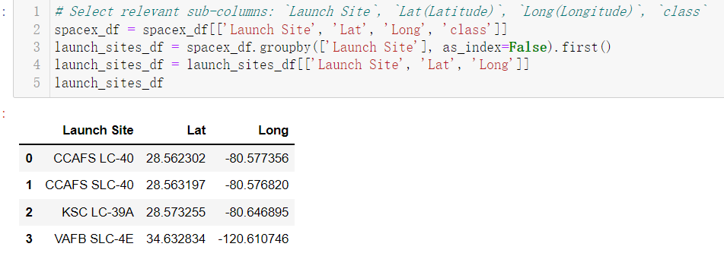
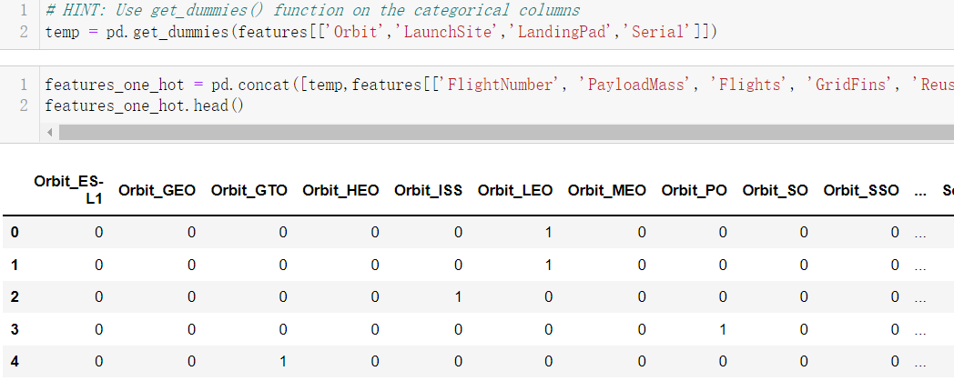
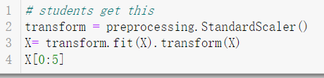
Data Wrangling
Describe how data were processed
Built classification models by applying packages from Sklearn and tune model using GridSearchCV. Using AUC-ROC curve, confusion matrix, and F1 score to evaluats
You need to present your data wrangling process using key phrases and flowcharts
Add the GitHub URL of your completed data wrangling related notebooks, as an external reference and peer-review purpose

Slide 11
EDA with Data Visualization
Summarize what charts were plotted and why you used those charts
Flight number V.S. Pay load mass(Scatter plot) to find out the outcome of the launch
Success rate of each orbit (Bar chart) to see which orbit perform better.
Year V.S. success rate(line chart) to find out how our tech perform when time goes by
Add the GitHub URL of your completed EDA with data visualization notebook, as an external reference and peer-review purpose

Slide 12
EDA with SQL
Using bullet point format, summarize the SQL queries you performed
Find unique launch sites in the space mission: %sql Select DISTINCT LAUNCH_SITE FROM SPACEXTBL
Show 5 records where launch sites begin with string ‘CCA’: SELECT * FROM SPACEXTBL WHERE LAUNCH_SITE LIKE ‘CCA%’ LIMIT 5
Total payload mass: SELECT SUM(PAYLOAD_MASS_KG_) FROM SPACEXTBL WHERE CUSTOMER = ‘NASA (CRS)’
Find certain payload mass based on different booster bersion
Ground pad where first landing were successfully achieved
Name of booster when payload mass was between a certain range
Number of total outcomes
Outcomes between certain date range

Slide 13
Build an Interactive Map with Folium
Summarize what map objects such as markers, circles, lines, etc. you created and added to a folium map
Using circle and add child to certain location to mark where it is; using marker to mark the size of the icon and color
Using folium.Map to show the whole map of USA; using circle to mark the radius and color as well as creating child.
Using mousePosition to get coordinate for a mouse over a point on the map
Using folium.Marker to mark the distance between to locations

Slide 14
Build a Dashboard with Plotly Dash
Summarize what plots/graphs and interactions you have added to a dashboard
Explain why you added those plots and interactions
Add the GitHub URL of your completed Plotly Dash lab, as an external reference and peer-review purpose

Slide 15
Predictive Analysis (Classification)
Summarize how you built, evaluated, improved, and found the best performing classification model
First by splitting the data into training and testing set
Using models from Sklearn packages to train each training set and then find out their accuracy
By using metrics like confusion matrix, F1 score and AUC-ROC curve we can directly see how the model perform on the data set
Besides decision tree, the other three models (logistic regression, SVM, KNN) have the same accuracy

Slide 16
Results
Exploratory data analysis results
Interactive analytics demo in screenshots
Predictive analysis results

Slide 17

Section 2

Slide 18
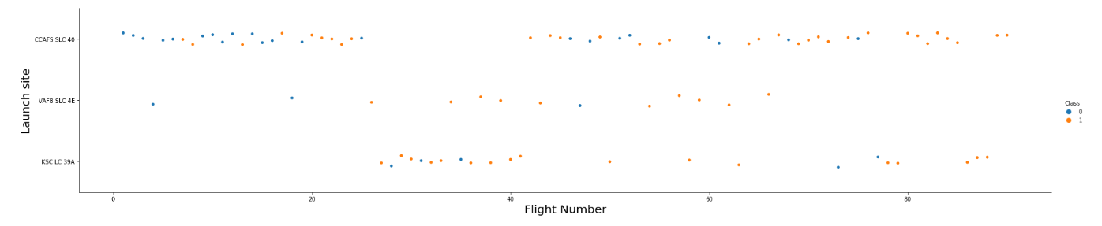
Flight Number vs. Launch Site
Show a scatter plot of Flight Number vs. Launch Site
The x-axis is flight number and y-axis is launch site. We can see that CCAFS SLC 40 site ahs the most flight number and VAFB SLC 4E has the least number of flights

Slide 19
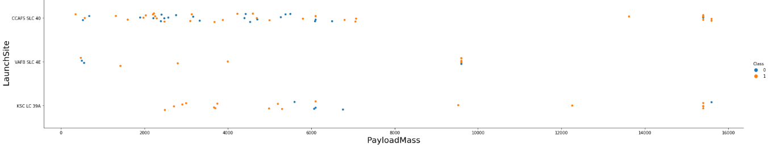
Payload vs. Launch Site
Show a scatter plot of Payload vs. Launch Site
Most of the payload are less than 8000, and still, CCAFS SLC 40 has most of the flights.

Slide 20
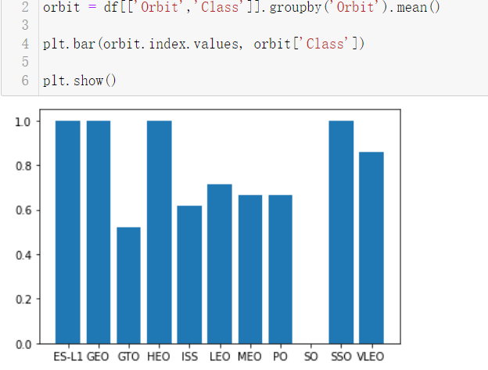
Success Rate vs. Orbit Type
Show a bar chart for the success rate of each orbit type

Slide 21
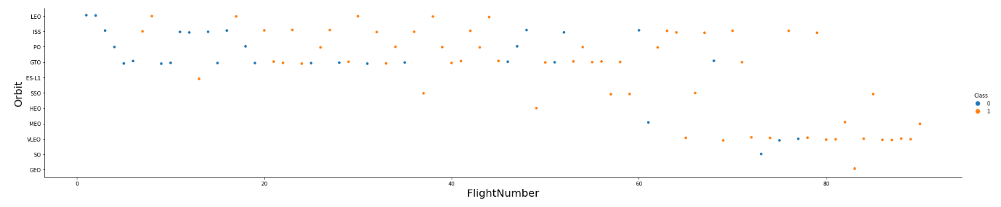
Flight Number vs. Orbit Type
Show a scatter point of Flight number vs. Orbit type

Slide 22
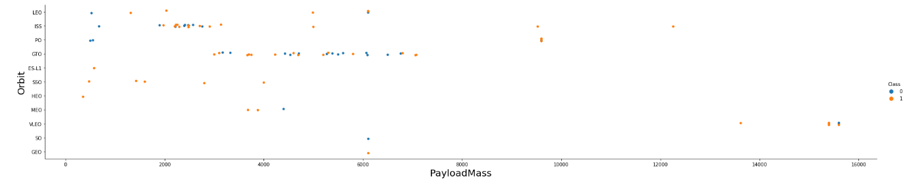
Payload vs. Orbit Type
Show a scatter point of payload vs. orbit type
Show the screenshot of the scatter plot with explanations

Slide 23
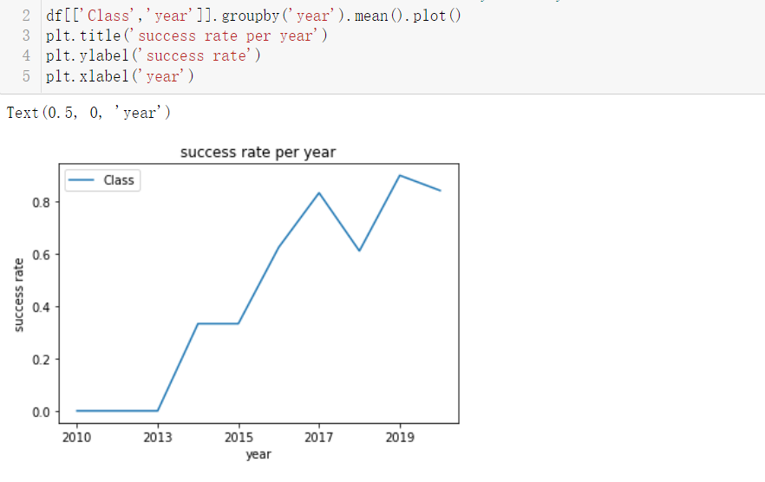
Launch Success Yearly Trend
Show a line chart of yearly average success rate
Show the screenshot of the scatter plot with explanations

Slide 24
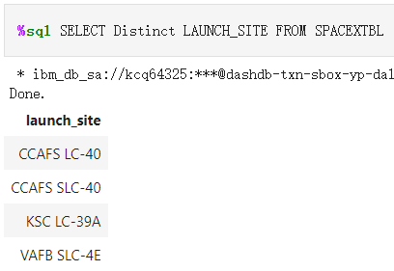
All Launch Site Names
Find the names of the unique launch sites
Present your query result with a

Slide 25
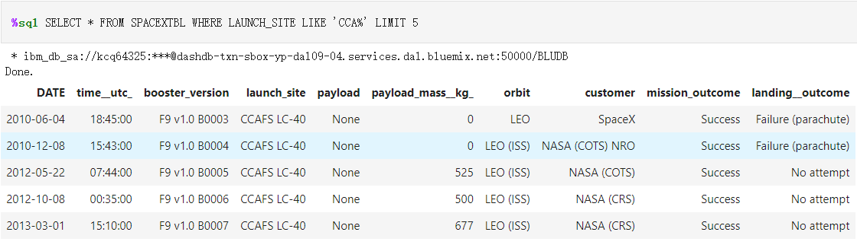
Launch Site Names Begin with 'CCA'
Find 5 records where launch sites begin with `CCA`
Present your query result with a short explanation here

Slide 26
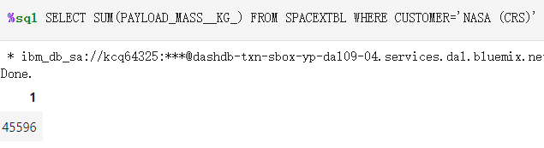
Total Payload Mass
Calculate the total payload carried by boosters from NASA
Present your query result with a short explanation here

Slide 27
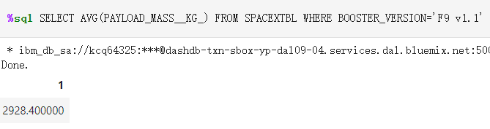
Average Payload Mass by F9 v1.1
Calculate the average payload mass carried by booster version F9 v1.1
Present your query result with a short explanation here

Slide 28
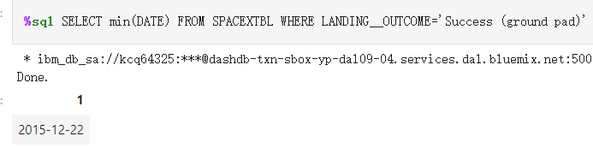
First Successful Ground Landing Date
Find the dates of the first successful landing outcome on ground pad
Present your query result with a short explanation here

Slide 29
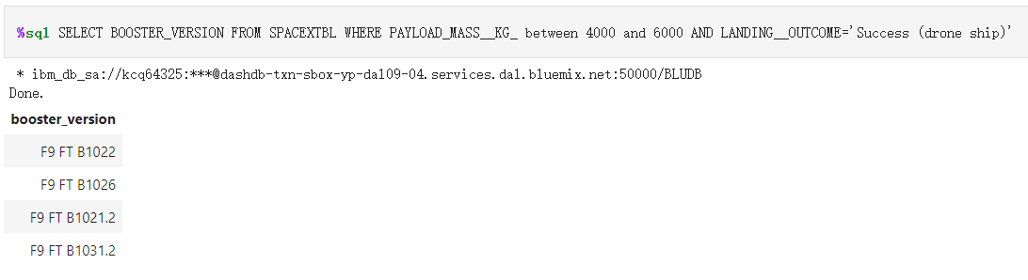
Successful Drone Ship Landing with Payload between 4000 and 6000
List the names of boosters which have successfully landed on drone ship and had payload mass greater than 4000 but less than 6000
Present your query result with a short explanation here

Slide 30
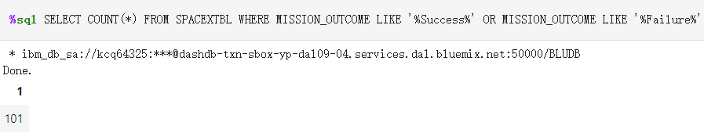
Total Number of Successful and Failure Mission Outcomes
Calculate the total number of successful and failure mission outcomes
Present your query result with a short explanation here

Slide 31
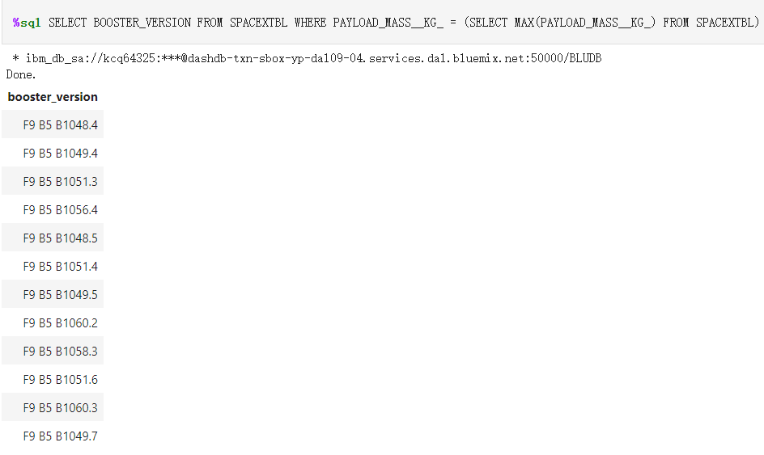
Boosters Carried Maximum Payload
List the names of the booster which have carried the maximum payload mass
Present your query result with a short explanation here

Slide 32
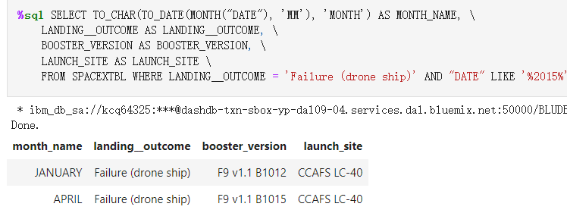
2015 Launch Records
List the failed landing_outcomes in drone ship, their booster versions, and launch site names for in year 2015
Present your query result with a short explanation here

Slide 33
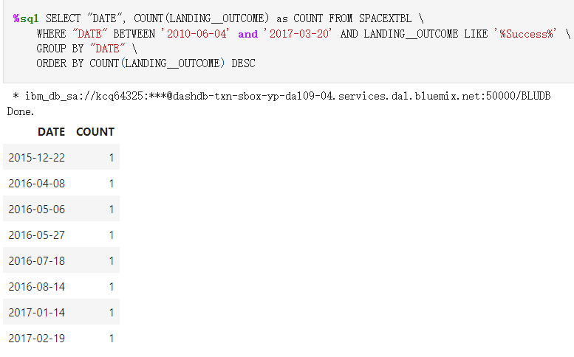
Rank Landing Outcomes Between 2010-06-04 and 2017-03-20
Rank the count of landing outcomes (such as Failure (drone ship) or Success (ground pad)) between the date 2010-06-04 and 2017-03-20, in descending order
Present your query

Slide 34

Section 3

Slide 35
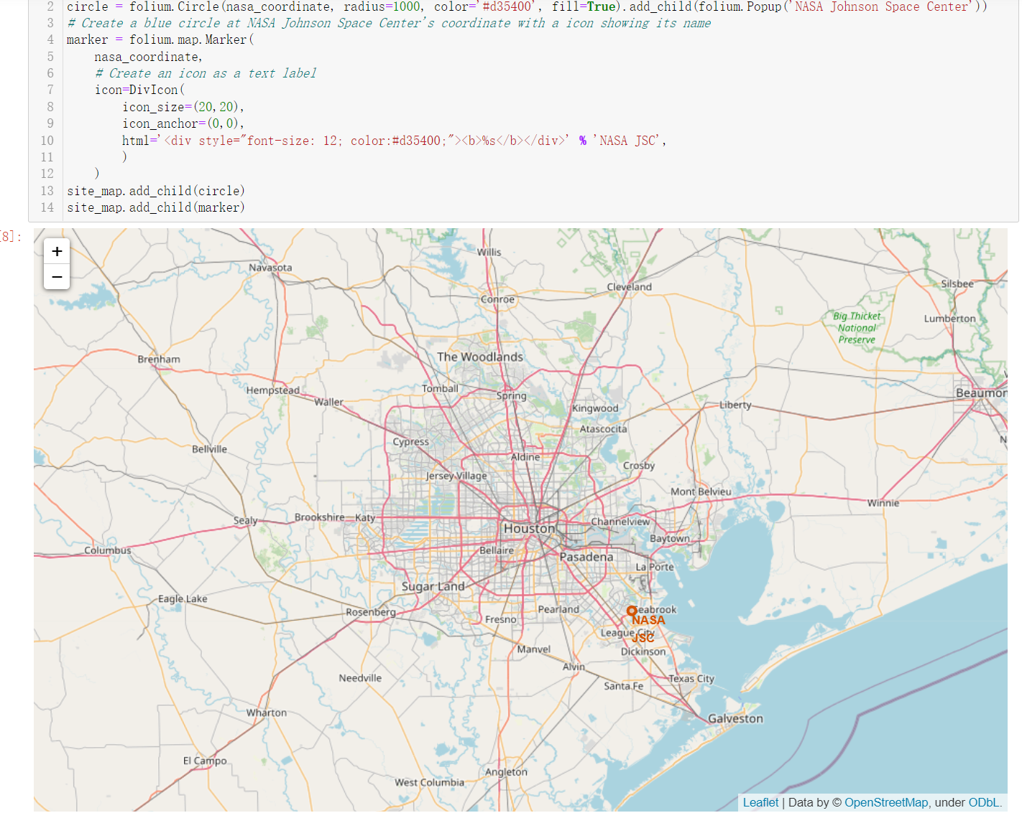
Houston NASA map
Replace <Folium map screenshot 1> title with an appropriate title
Explore the generated folium map and make a proper screenshot to include all launch sites’ location markers on a global map
Explain the important elements and findings on the screenshot

Slide 36
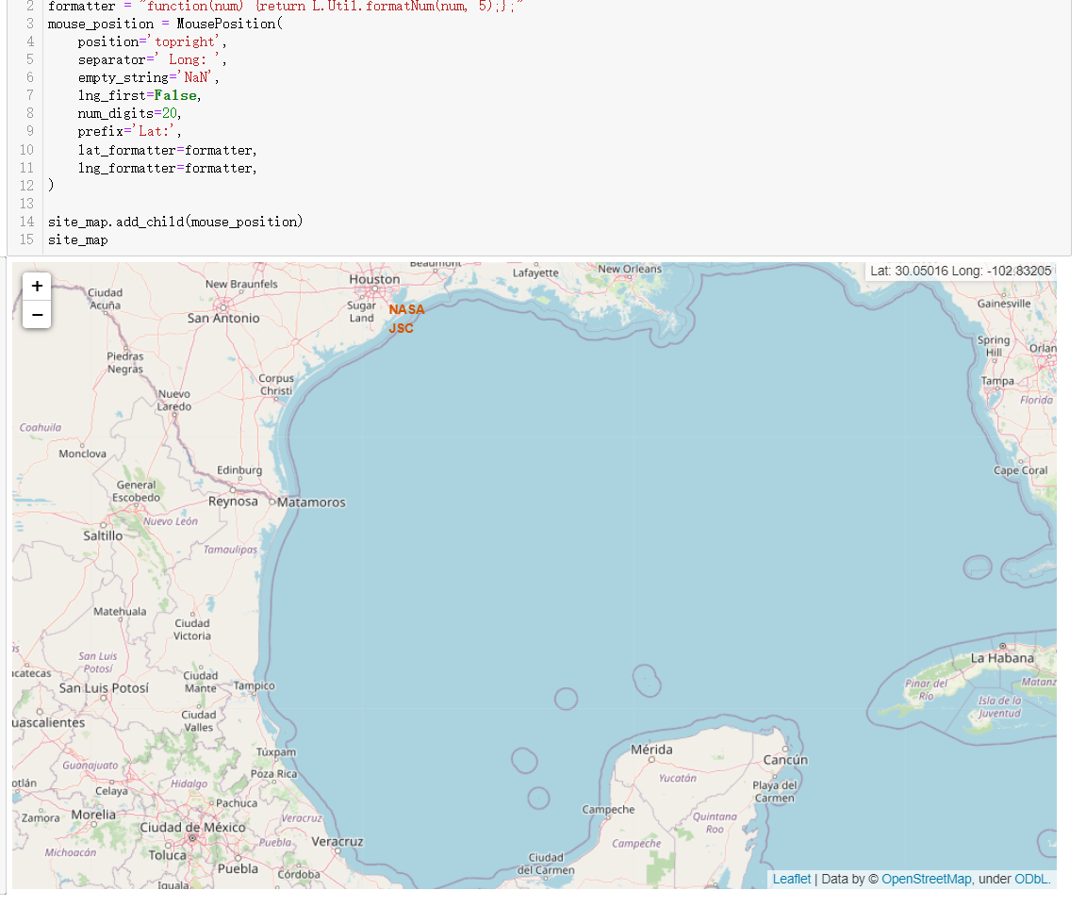
Distance Calculation Map
Replace <Folium map screenshot 2> title with an appropriate title
Explore the folium map and make a proper screenshot to show the color-labeled launch outcomes on the map
Explain the important elements and findings on the screenshot

Slide 37
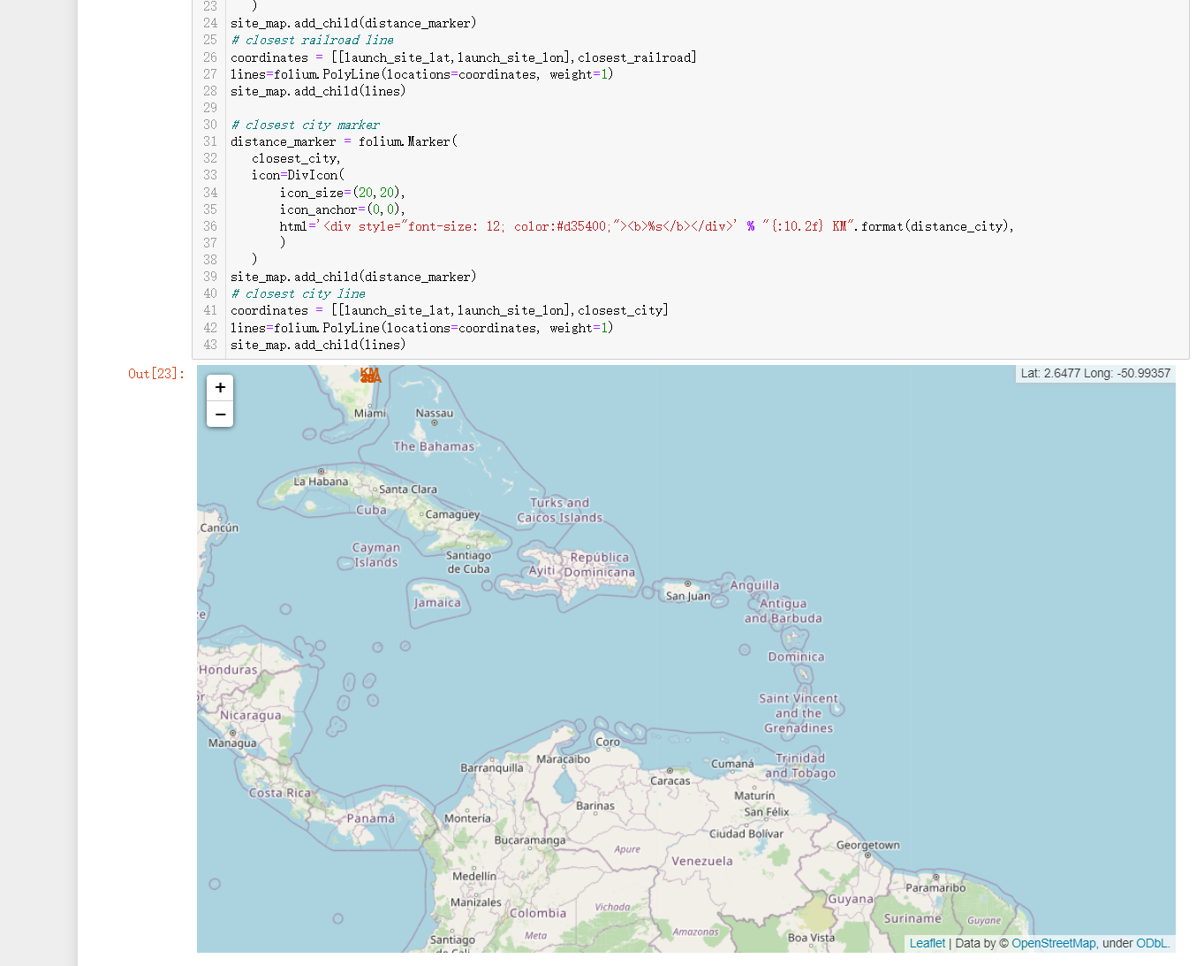
Southern map
Replace <Folium map screenshot 3> title with an appropriate title
Explore the generated folium map and show the screenshot of a selected launch site to its proximities such as railway, highway, coastline, with distance calculated and displayed
Explain the important elements and findings on the screenshot

Slide 38

Section 4

Slide 39
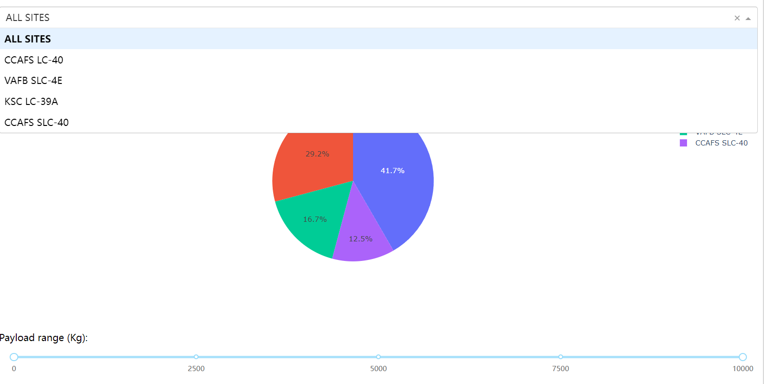
Sites V.S. payload range
Replace <Dashboard screenshot 1> title with an appropriate title
Show the screenshot of launch success count for all sites, in a piechart
Explain the important elements and findings on the screenshot

Slide 40
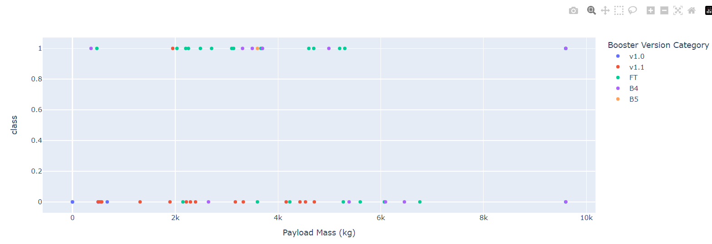
Payload V.S. Class
Replace <Dashboard screenshot 2> title with an appropriate title
Show the screenshot of the piechart for the launch site with highest launch success ratio
Explain the important elements and findings on the screenshot

Slide 41
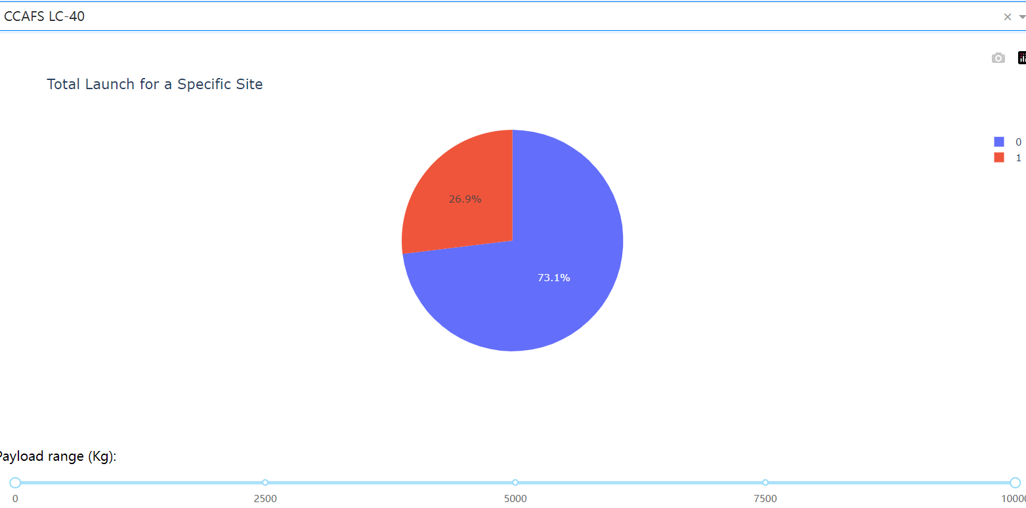
Site that has the most flights
Replace <Dashboard screenshot 3> title with an appropriate title
Show screenshots of Payload vs. Launch Outcome scatter plot for all sites, with different payload selected in the range slider
Explain the important elements and findings on the screenshot, such as which payload range or booster version have the largest success rate, etc.

Slide 42

Section 5

Slide 43
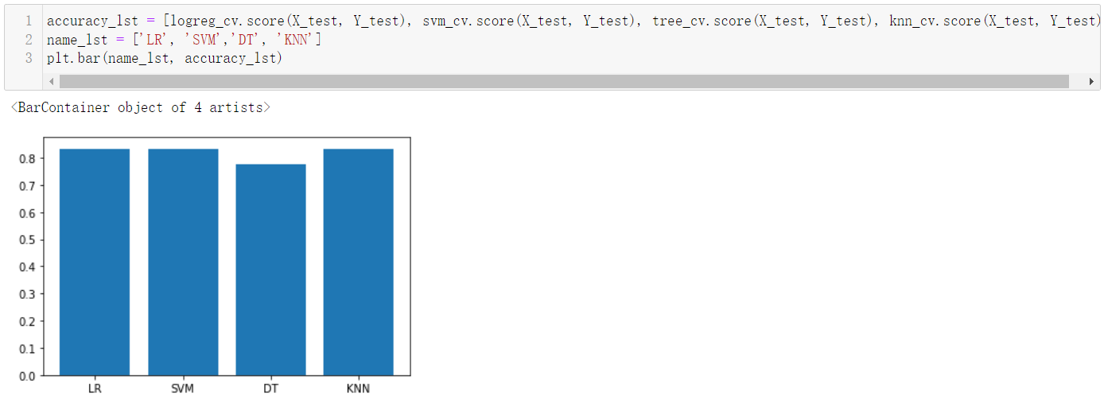
Classification Accuracy
Visualize the built model accuracy for all built classification models, in a bar chart
Find which model has the highest classification accuracy

Slide 44
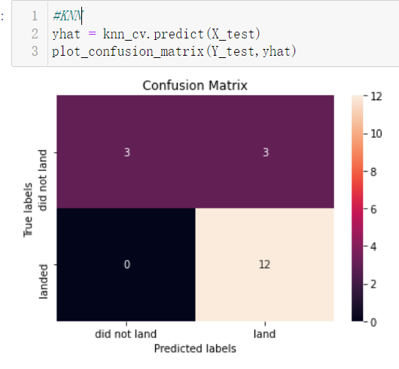
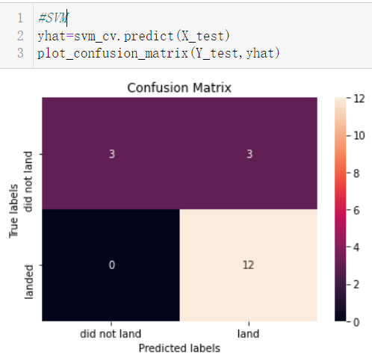
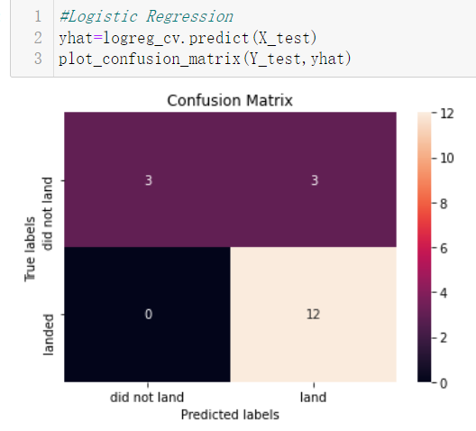
Confusion Matrix
Show the confusion matrix of the best performing model with an explanation

Slide 45
Conclusions
Point 1
Point 2
Point 3
Point 4
…

Slide 46
Appendix
Include any relevant assets like Python code snippets, SQL queries, charts, Notebook outputs, or data sets that you may have created during this project

Slide 47


